Slide 1
A Seminar on IOT Controller for Industrial Automation (Apache webserver and Esp8266)
Prepared by
Ajith Gorde
Akash Lad
Shivani Muthekar
Mangesh Divate
Guided by
Prof. Shailash Jadhav
Department of Electronics & Telecommunication Engineering Dhole Patil College of Engineering, Pune.

Slide 2
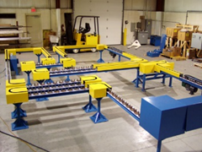
Project Highlights
Introduction
Industrial Automation
Controlling industrial appliances remotely.
Project based on python,javascript,lua,esp8266,Apache server
Necessity
To reduce human effort & preserve time
Fast and real-time monitoring of remote location
Contribution towards smart city
Objective
To monitor and control temperature of boiler
To implement user friendly web interface to control industrial devices
To Design Gesture Sensor To control the speed of the conveyor belt
To

Slide 3
Literature Survey
History
Inefficient and indirect control on industrial environment and devices
impact both productivity and economy
Literature Survey of the Project
Provide direct access to industrial environment
Provides remote surveillance platform to the authenticated users e.g. Mangers , directors

Slide 4
Block Diagram

Slide 5
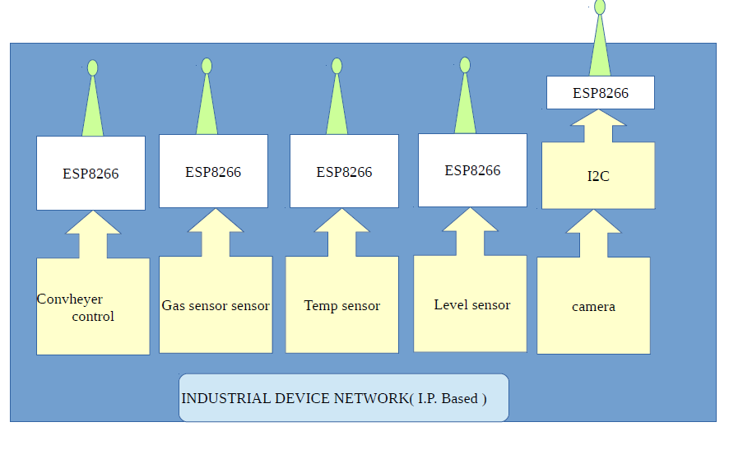
Block Diagram
Conveyor control
Gas sensor

Slide 6
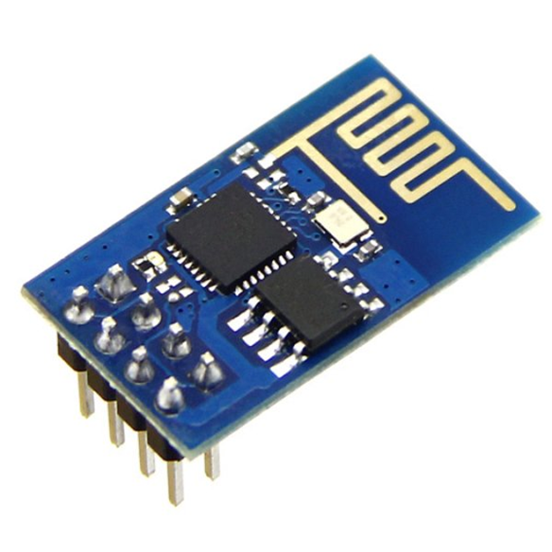
Microcontroller (ESP 8266 part no.485-2471)
Survey /Selection criteria
Controller should support multitasking
ARM processors are costlier
Features
One chip WIFI stack as well as SPI, I2C bus
Advanced RISC Architecture
It supports Real time OS
It has 64kB of RAM
Electrical specification
Operating Voltages: – 3.0 – 4.0V in ideal mode
Current requirement: 12-15mA

Slide 7
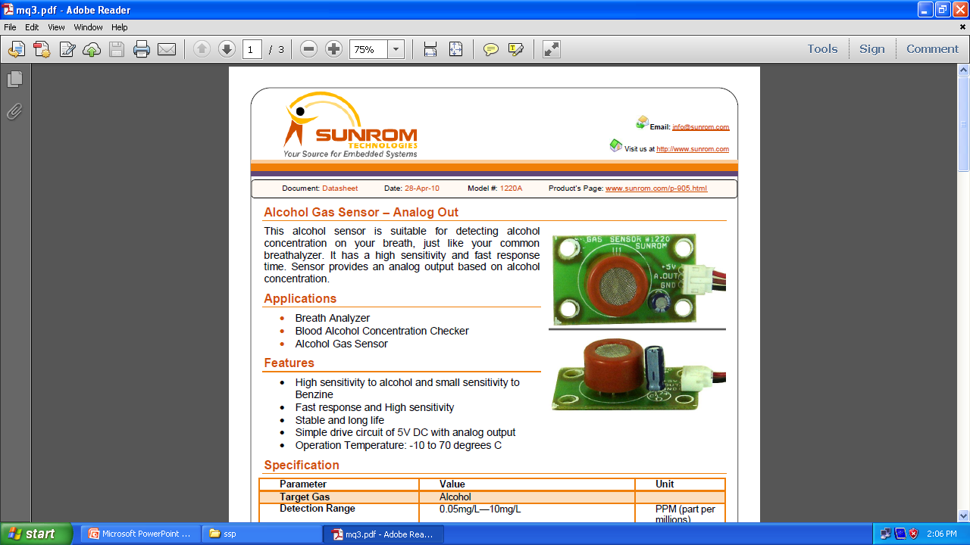
GAS SENSOR(Model#:1220A)
Working
Suitable for detecting Methane & CO2 concentration
Features
High sensitive to Methane & less sensitive to CO2
Fast response and High sensitivity
Stable and long life
Electrical Specifications
Working voltage : 5V DC
Operation Temperature: -10 to 70 degrees C

Slide 8
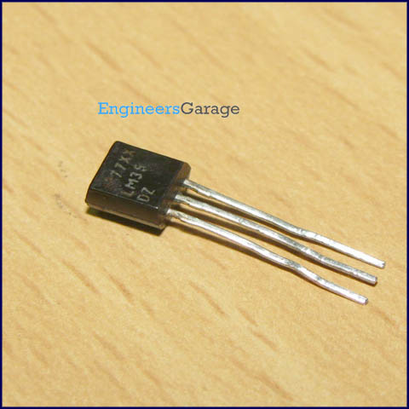
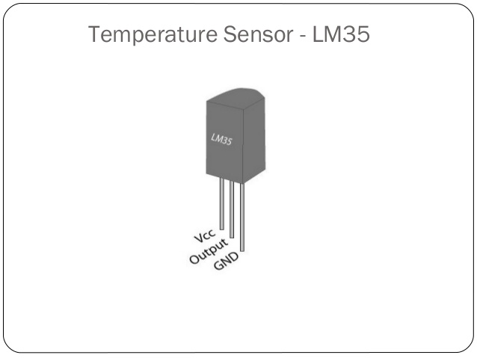
TEMPERATURE SENSOR(Model#:1220A)
Working
Suitable for detecting Temperature , Ex: Boiler
Features
Low impedance output, 0.1 Ω for 1 mA load
Suitable for remote applications
Calibrated directly in ˚ Celsius (Centigrade)
Less than 60 µA current drain
Electrical Specifications
Operates from 4 to 30 volts
Operation Temperature: −55˚ to +150˚C range

Slide 9
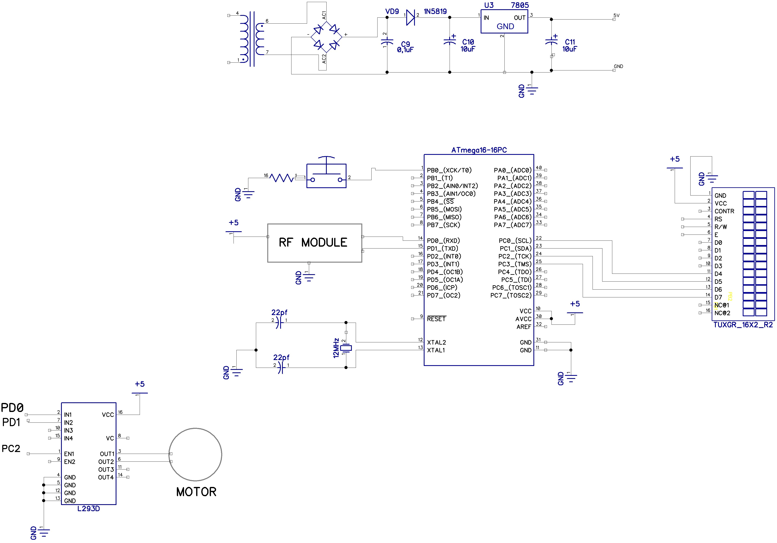
L293D (SLRS008B)
Working
L293D IC accept small current, amplify it and generate large current which further drives a motor
Features
Internal ESD Protection
Thermal Shutdown
High-Noise-Immunity Input
Electrical Specification
The L293D is designed to provide bidirectional drive currents of up to 600-mA at voltages from 4.5 V to 36 V
L293D are characterized for operation from 0°C to 70°C

Slide 10
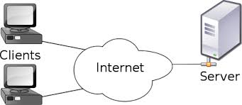
Apache web server
Multiple Request Processing modes (MPMs) including Event-based/Async,
Highly scalable (easily handles more than 10,000 simultaneous connections)
Dynamic configuration
IPv6-compatible
Real-time status views

Slide 11
Communication and Protocol
Server
FOC/TPC
TCP
HTTP
Gateway
Wifi
Tcp
mqtt
Device
sensors
FOC/TPC
TCP
HTTP
Remote user

Slide 12
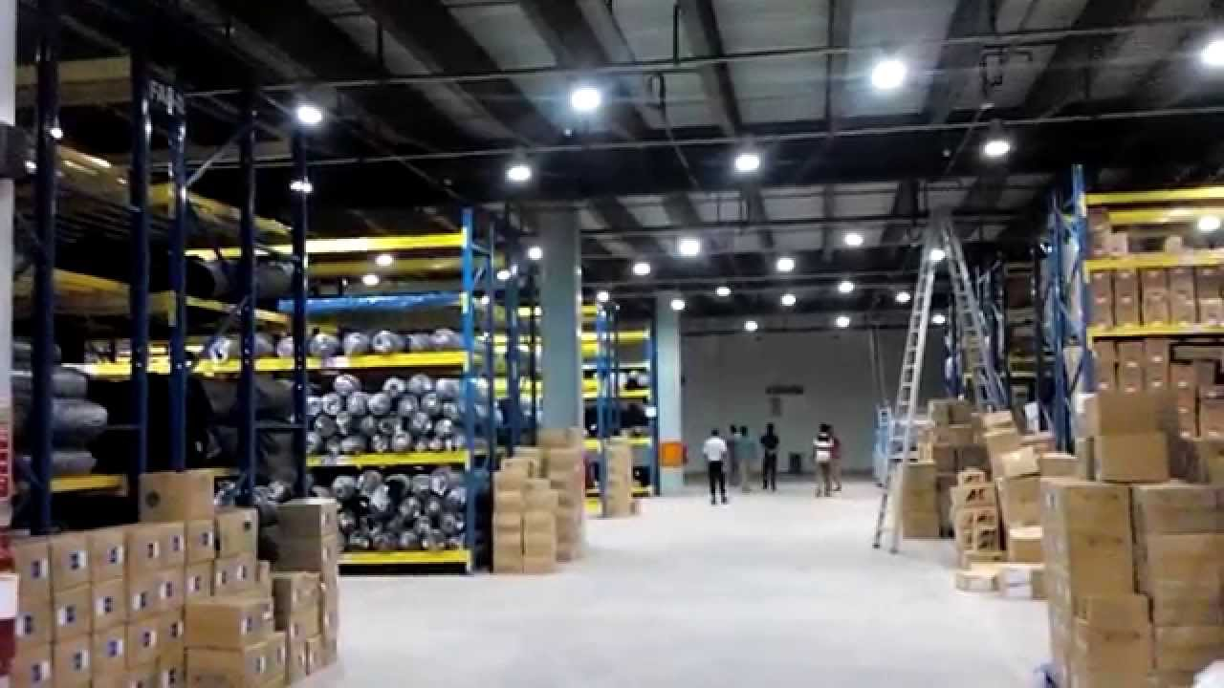
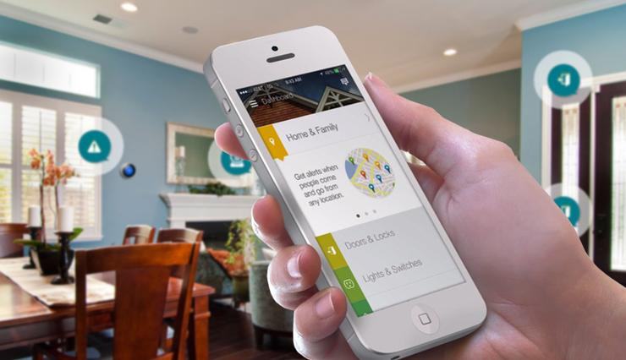

Slide 13
Login
Flow Chart
Shows current status of industrial appliances
Manipulate changes
Send changes to public IP of Industry
ESP 8266 will notify to specific client
Check the feedback from device using sensor
Update feedback to server(database)

Slide 14
Advantages
Advantages, Future Scope, Conclusion
Increase Productivity
Very low power consumption
Provides instant & valuable info. About Energy consumption w.r.t time
Future Scope
Forecasting Accidental condition using AI algorithm on logged data
Conclusion
It is good to control devices remotely instead of travelling along to your factory just to control few devices
It saves time as well as vehicle fuel
Provides data for future big data analysis

Slide 15
Gesture sensor

Slide 16
References
https://github.com/mqtt/mqtt.github.io/wiki/software?id=software
Internet of Things with Python author Gastón C. Hillar publication Tata mcgrahill
ESP 8266 data sheet
T. Kindberg, M. Chalmers, and E. Paulos, “Guest Editors’ Introduction: Urban Computing,” IEEE Pervasive Computing, vol. 6, no. 3, 2007, pp. 18–20; doi: 10.1109/ MPRV.2007.57.
F. Zambonelli, “Pervasive Urban Crowdsourcing: Visions and Challenges,” Proc. IEEE Int’l Conf. Pervasive Computing and Communications, IEEE CS, 2011, pp. 578–583; doi: 10.1109/PERCOMW.2011.5766956.

Slide 17
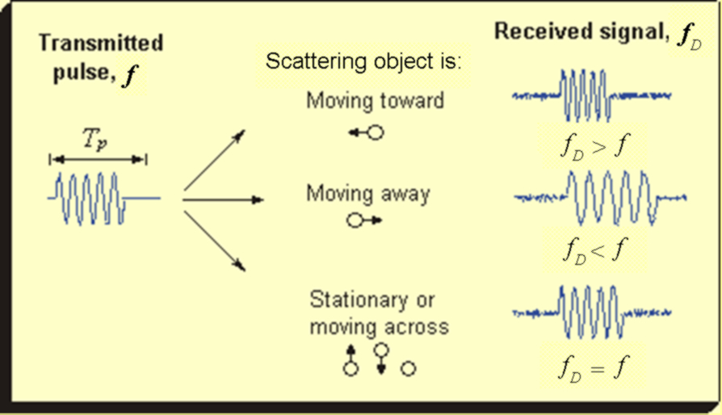
Doppler concept

